Slide 1

Termination Decisions: Training for Supervisors
Presented by: Thomas Faulkner

Slide 2
Introduction
Making the decision to terminate an employee and conducting the termination meeting are two of the most difficult responsibilities managers have.
Knowledge of the laws and best practices as well as training help both the manager and the employee end the relationship on a positive note.
It is essential that all managers, in addition to human resource staff, acquire appropriate knowledge to make these important decisions and to conduct professional termination meetings.

Slide 3
Agenda
Types of terminations
Primary laws that pertain to involuntary terminations
Employment at will
Our policy on involuntary terminations
Documentation
Guidelines for the termination meeting

Slide 4
Types of Terminations:
Voluntary
An employee provides a resignation stating his or her intention to leave the organization within a specified period of time.
Reasons for voluntary terminations include:
A new job.
Personal reasons (e.g., relocation, health, family obligations).
Retirement.

Slide 5
Types of Terminations:
Involuntary
The employer initiates termination of an employee’s employment.
Reasons for involuntary terminations include:
Unsatisfactory performance
Includes situations in which the employee fails to satisfactorily perform the essential functions of his or her position and to meet established goals; also includes issues such as excessive absenteeism.
Organizational change
Includes layoffs and reductions in force.
Misconduct
Includes violations of the employer’s code of ethics and conduct, policies, practices, procedures or rules.

Slide 6
Primary Laws That Pertain to Involuntary Terminations
Title VII of the Civil Rights Act of 1964: Prohibits employers from terminating employment based on race, color, religion, gender and national origin.
Pregnancy Discrimination Act (PDA): An amendment to Title VII, prohibits termination of employment based on pregnancy and childbirth.
Americans with Disabilities Act (ADA): Prohibits employers from terminating employment based on disability.
Age Discrimination in Employment Act (ADEA): Prohibits employers from terminating employment based on being age 40 and older.
Uniformed Services Employment and Reemployment Rights Act (USERRA): Prohibits employers from terminating employment based on military service.
Family and Medical Leave Act (FMLA): Prohibits employers from terminating employment based on requesting FMLA leave or use of FMLA leave.

Slide 7

Employment at Will
Employment at will is a doctrine. It is not a law.
Employment at will pertains to the employer’s right to terminate the employment relationship at any time, for any reason, with or without notice, as long as the employer does not violate oral or written contracts, public policy, or covenant of good faith and fair dealing.

Slide 8
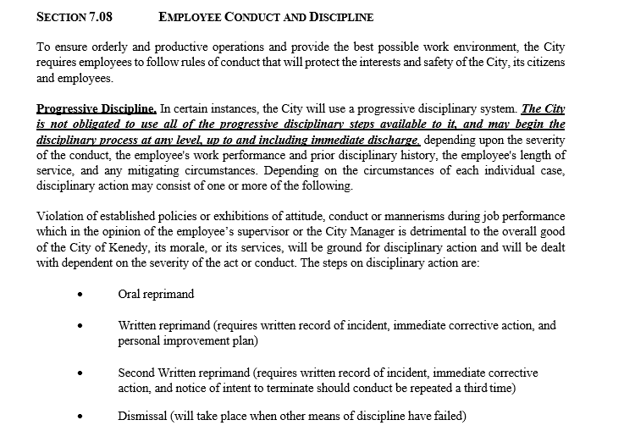
Our Policy on Involuntary Terminations

Slide 9
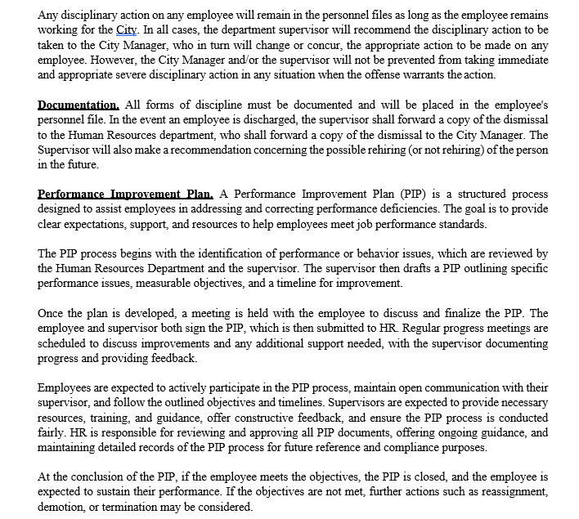
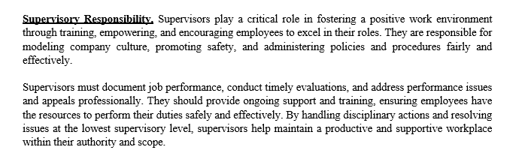
Our Policy on Involuntary Terminations (cont.)

Slide 10
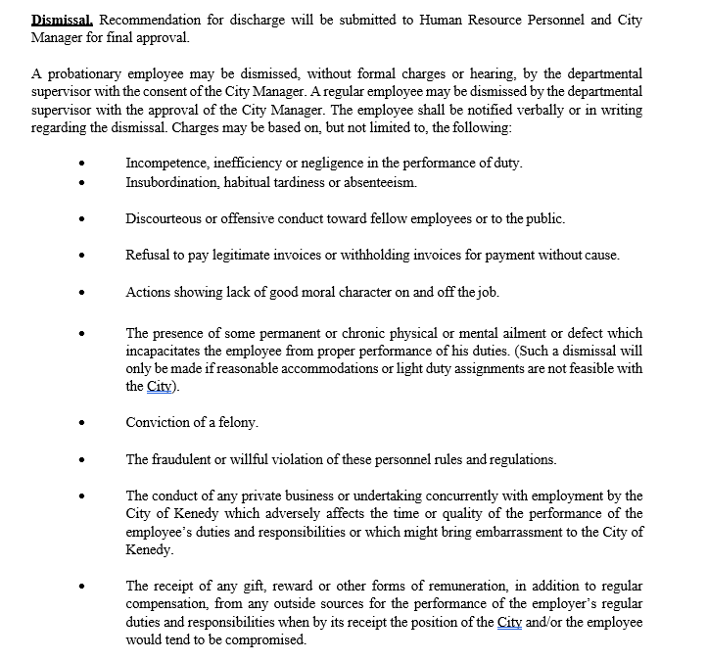
Our Policy on Involuntary Terminations (cont.)

Slide 11

Documentation
To establish credibility and to support your termination decision, you must objectively document incidents, poor performance and conversations with employees.
Be sure to include in your documentation:
The dates of any incident or conversation between you and a problem employee. Documenting events shows that the decision to terminate an employee is supported by a record of prior incidents.
A record of violations of policies or procedures, such as poor performance, absenteeism, insubordination, disruptive behaviors and unethical behavior. Whenever possible, include the language the employee used and how the incident affected your department or the company as a whole.

Slide 12
Documentation (cont.)
Details of conversations you had with the employee and any disciplinary actions you took in response to the employee’s performance deficiencies. Also note realistic guidelines you gave the employee and deadlines you set for improvement.
Employee appraisals performed, details of meetings that took place to determine an employee’s progress toward established goals and notes regarding the employee’s level of participation throughout the process.
A record of giving verbal or written warnings to the employee. The employee must sign a document that acknowledges receipt of each warning.

Slide 13
Guidelines for the Termination Meeting
Before the termination meeting:
Have written notes for what to communicate.
Time the meeting carefully.
Hold the discussion in private.
Schedule a conference room in advance, if necessary.
Consider having a representative from human resources or another manager in the room.

Slide 14
Guidelines for the Termination Meeting (cont.)
During the termination meeting:
Avoid small talk.
Remain calm.
Clearly state the reason for the termination.
Avoid personal references or accusations.
Make it clear that the employee is terminated, and that negotiation is not possible.
Be prepared for the employee’s reaction.
Discuss all issues that need to be “closed” (e.g., benefits, final paycheck, company property).
Provide a copy of the separation notice.
Walk employee to the exit of the building if security is not available.

Slide 15
Summary
The two types of terminations are voluntary and involuntary.
Reasons for termination include unsatisfactory performance, organizational change and misconduct.
The primary laws that pertain to terminations are Title VII, the PDA, ADA, the ADEA, USERRA and the FMLA.
The employment-at-will doctrine (not a law) pertains to the employer’s right to terminate the employment relationship at any time, for any reason, with or without notice, as long as the employer does not violate oral or written contracts, public policy, or covenant of good faith and fair dealing.
In our company, we have a progressive disciplinary policy and specific procedures to follow in conducting a termination.
Documentation needs to include dates of incidents, conversations, violations, disciplinary actions, performance appraisals, a record of any verbal warnings given, all written warnings and written acknowledgement by the employee of receipt of a warning.
Our guidelines for a termination cover proper preparation before the termination meeting and how to conduct the actual meeting.

Slide 16
Questions?

